Slide 1


Slide 2



Slide 3

1. Welcome –Kevin Violette - President
2. Announcements – Kevin Violette
- Treasurer’s Report: Wayne Smith
- Membership Fees: $40 are due one year from date of last payment.
- Meetings will continue at this Hall on the 4th Thursday of every month except Dec. and ending in June.
- Communications will continue by direct email to members and on our Facebook page.
- Twoonie Half & Half Draw: Tickets are $2 each or 3 for $5. (See Ken Cruse)
- Please help with Hall cleanup: tables, chairs, and some kitchen work.
3. Upcoming Events: • Sept. 24th First Meeting of the New Program Year
7:00 p.m. Theme to be determined based on Member Input Survey
• 2026 Hamilton Woodworking Show - November 13–15
Riverside Exhibition Centre (Caledonia Fairgrounds)
____________________________________________________________________________________________________________________
DINNER - Catered by Merritville Smokehouse & Broasted Chicken
-AWARDS PRESENTATION-
Winners of Our Three Maker’s Challenges
MEMBER SURVEY - PROGRAM INPUT FOR THE COMING YEAR
Survey sheet – check off your preferred choices – 5 skills and 3 Maker’s Themes
SWAP – SELL - TRADE - GIVE AWAY TABLES -
______________________________________________________________________________________________________________________________________________________________________________________________________________________________________________________________________________________________________________________________________________________________________________________________________________________________________
5. Show-and-Share – Member projects and special tools.
6. Twoonie-Half-N-Half Draw – Funds to help with Club operational expenses.

Slide 4

- 2027
MEETING DATES
2026:
September 24
October 22
November 26
December (no meeting)
2027:
January 28
February 25
March 25
April 22 (note 5 weeks)
May 27
June 24 (no July/Aug mtgs)
Meetings begin at 7:00 p.m.
4th Thursday of the Month
PROGRAM THEMES
and
MAKER’S CHALLENGES
To be determined with
input of Club Members

Slide 5
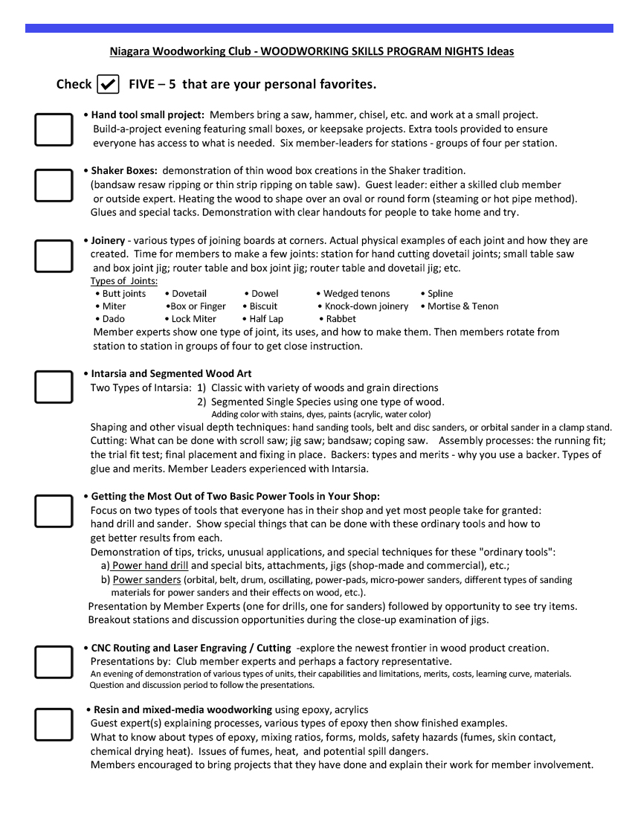

Slide 6
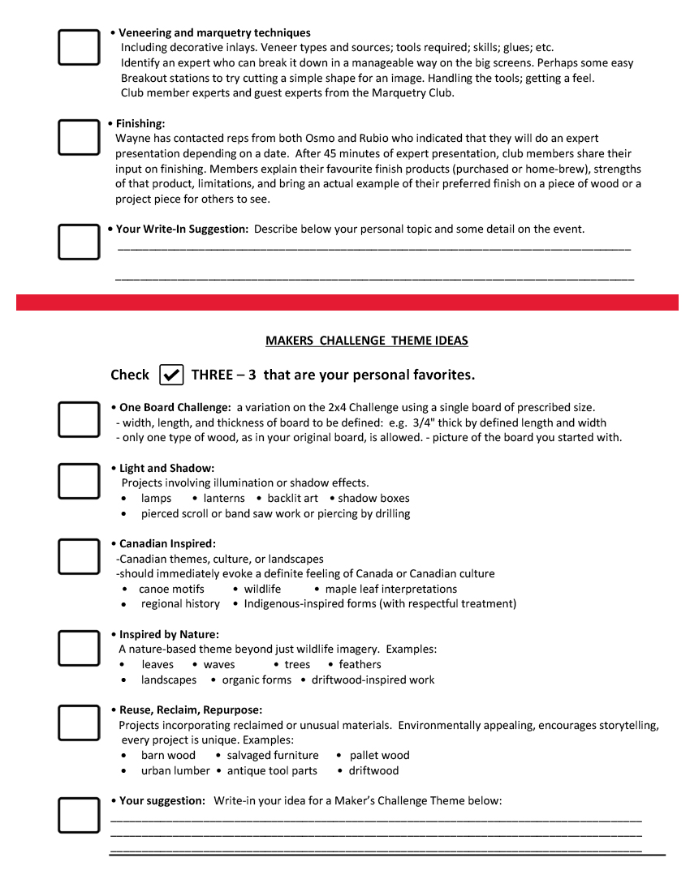

Slide 7
Maker’s Challenge Awards
Toys and Games Challenge Winners
1. Wayne Smith 2. Virgil Parvu 3. Jeff Hetherington
Sponsored by Lee Valley, Niagara Falls
Firewood Challenge Winners
1. Bob Hayward 2. Martin Keuse 3. Joe Sebastianelli
Sponsored by Stockroom Supply, Wainfleet
Wall Art Challenge Winners
1. Don Beaudreau 2. Heather Brooks 3. Chris White
Sponsored by The Woodshed, Smithville

Slide 8


Slide 9

- FUNDS SUPPORT -
NIAGARA WOODWORKING CLUB OPERATIONS
• Hall Rental and Meeting Expenses
• Coffee supplies and Snacks
• Event Challenge Awards
• Website Hosting Fees

Slide 10
- 2027
MEETING DATES
2026:
September 24
October 22
November 26
December (no meeting)
2027:
January 28
February 25
March 25
April 22 (note 5 weeks)
May 27
June 24
Meetings begin at 7:00 p.m.
4th Thursday of the Month
PROGRAM THEMES
and
MAKER’S CHALLENGES
To be determined with
input of Club Members

