Slide 1


Slide 2

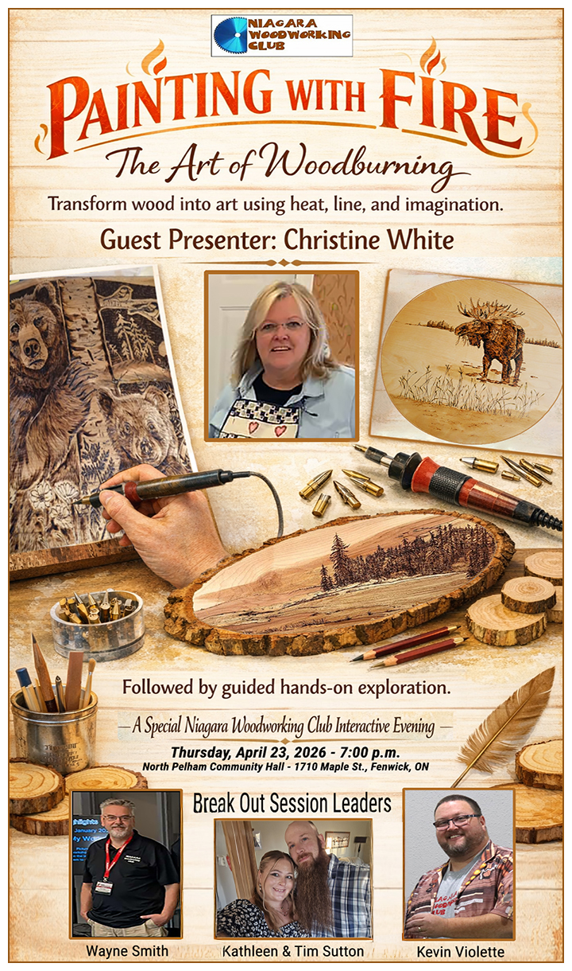
Thursday, April 23rd
Live Demo of
Pyrography
Christine White
Followed by
Hands-On
Breakout Stations
With
Kathleen & Tim Sutton
Wayne Smith
Kevin Violette

Slide 3

1. Welcome –Kevin Violette - President
2. Introductions – Welcome to all guests! Invitation to tell us about yourself.
Announcements – Kevin Violette
Membership Fees: $40 are due one year from date of last payment. (Bob White)
Twoonie Half & Half draw tonight. Tickets are $2 each or 3 for $5. (See Ken Cruse)
Technology Upgrades: Our new 70” TV screen - cash donations still needed – see Wayne Smith.
Upcoming Events: May 28th Makers Challenge: Wall Art! See Guideline sheet
May 30th The Woodshed Woodworking Show – Team of 6 members needed
8:15 to 11:00 a.m. Set up and host visitors - 11:00 a.m. to 2:00 p.m. Host and tear down.
4 Tonight’s Program: ❞Painting With Fire – The Art of Woodburning❞ Christine White
Followed by Break-Out stations where you can try Pyrography tools and techniques.
Break-Out Leaders: Kathleen and Tim Sutton; Wayne Smith; Kevin Violette
5. Refreshment Break and Networking.
6. Show-and-Share – Member projects and special tools.
7. Twoonie-Half-N-Half Draw – Funds to help with Club operational expenses.
8. Next Meeting: May 28th Makers Challenge: WALL ART – Corporate Sponsor: The Woodshed, Smithville
• Cash cards for 1st, 2nd, 3rd place entries: $100, $50, $25

Slide 4

UPCOMING MEETING DATES and THEMES
Makers Challenge: Wall Art
Creative Décor for Homes, Offices, Galleries
May 28, 2026
Corporate Sponsor Prizes by The Woodshed
$100.00, $50.00, $25.00 Gift Certificates
End-of-Year Awards & Appreciation Dinner
Thursday, June 25, 2026 at 6:00 p.m.
Certificates to Makers Choice Winners
Participation Draws
Planning for Next Year’s Program
Swap and Sell Tables
Bring your tools and woodworking stuff to sell, swap or give away!

Slide 5


Slide 6


Slide 7


Slide 8

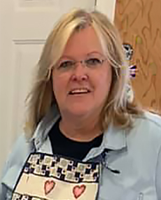


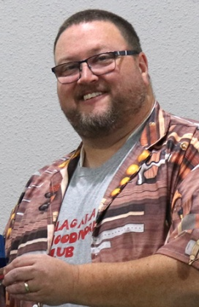
Christine White
Sandpiper Studio Arts
-Presenter-
- - - - - Breakout Group Leaders - - - - -
Wayne Smith
Kathleen & Tim Sutton
Kevin Violette

Slide 9
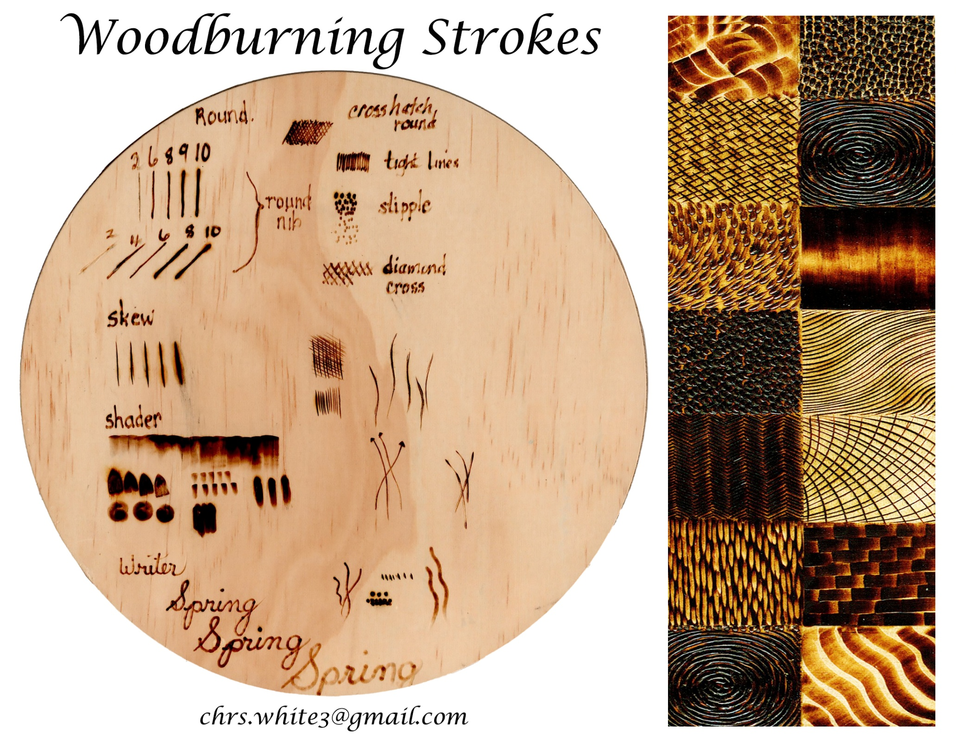

Slide 10


Slide 11


Slide 12

- FUNDS SUPPORT -
NIAGARA WOODWORKING CLUB OPERATIONS
• Hall Rental and Meeting Expenses
• Coffee supplies and Snacks
• Event Challenge Awards
• Website Hosting Fees

Slide 13
UPCOMING MEETING DATES and THEMES
Makers Challenge: Wall Art
Creative Décor for Homes, Offices, Galleries
May 28, 2026
Corporate Sponsor Prizes by The Woodshed
$100.00, $50.00, $25.00 Gift Certificates
End-of-Year Awards & Appreciation Dinner
Thursday, June 25, 2026 at 6:00 p.m.
Certificates to Makers Choice Winners
Participation Draws
Planning for Next Year’s Program
Swap and Sell Tables
Bring your tools and woodworking stuff to sell, swap or give away!

